Slide 1

KING COUNTY HOUSING PRICE PREDICTION MODEL
Data Driven solutions for the King County real estate market

Slide 2
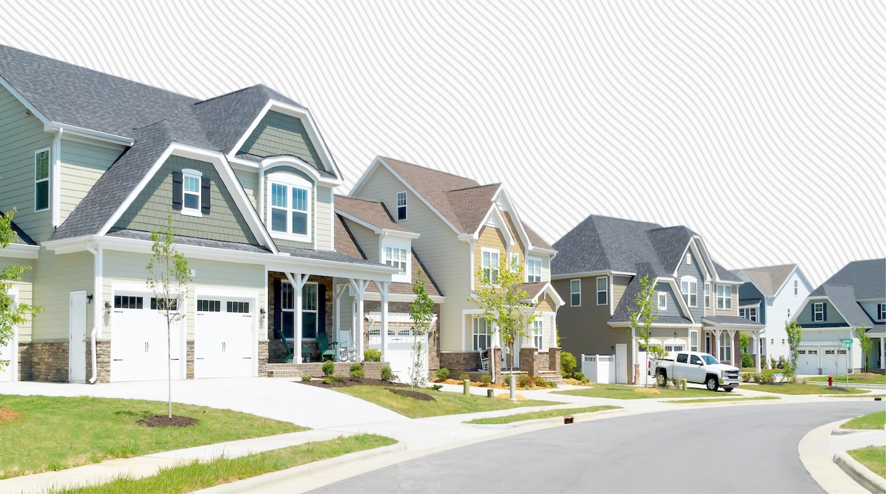
OVERVIEW
This project was completed using data for the dataset provided by King County, Washington.
The goal for is to come up with a suitable model for a real estate company in Washington that will be used to predict house prices which will enable them maximize on the profits

Slide 3
Business Understanding
A company's real estate agent is curious about the elements that have a major influence on King County home values. This will help in formulating the optimal criterion to follow in order to optimize profit.

Slide 4
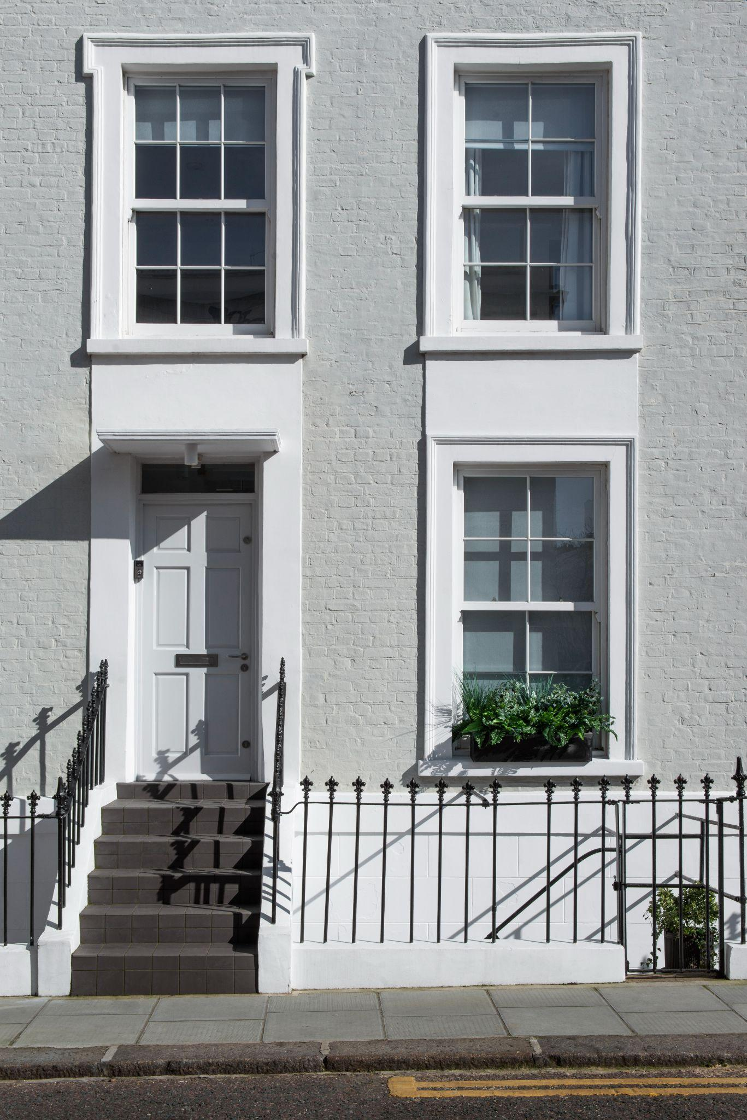
PROBLEM STATEMENT
Given the complexity of factors that can affect the sale price of a house it is challenging to get a precise assessment
Data driven analysis can provide key insight to agencies and clientele to help them make informed decisions

Slide 5
Objectives
Develop a predictive model for accurate house price estimations
Identify key determinants that affect house pricing
Investigate the impact of waterfront view on price
Evaluate the impact of House condition on price
Determine the impact of house grade on price

Slide 6
METHODOLOGY AND TECHNIQUES
The research used an iterative method to visualize attributes in connection to price, create a multiple linear regression model using Python and Stats Models to predict house sale prices, and discover characteristics that influence King County house prices.

Slide 7
DATA UNDERSTANDING
• There are 21597 records with 20 features in the King County data.
• Some null values in the waterfront, view, and year of renovation are present in the data.
• The highest-priced home sold for about $7,700,000, while the average is almost $540,000.
• The average house grade is 7, which indicates that the majority of sold homes have grades above average.
• In King County, the highest number of floors in a residence is 3.5.

Slide 8
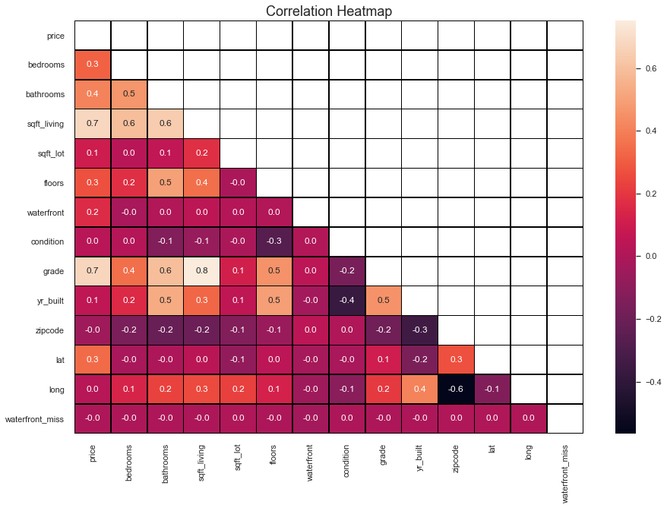
Selected columns with highest correlations (sqft_living: 0.704652, grade: 0.667224, bathrooms: 0.527350) for modeling

Slide 9
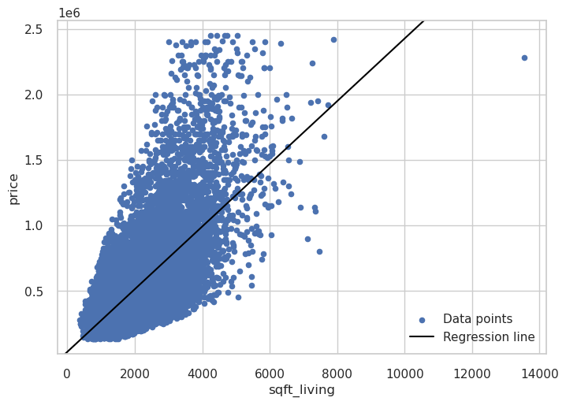
Baseline Model
linear regression model based on independent variable that has highest number of correlation with price
Based on the model the living space increases price tends to increase by $239 per square foot.

Slide 10
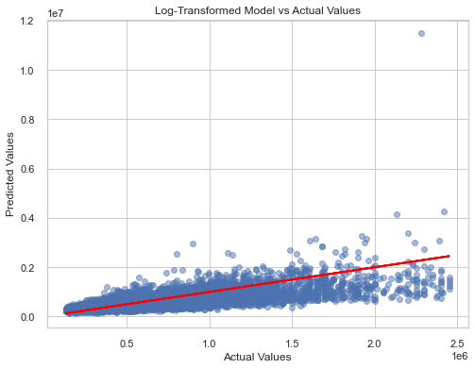

Slide 11
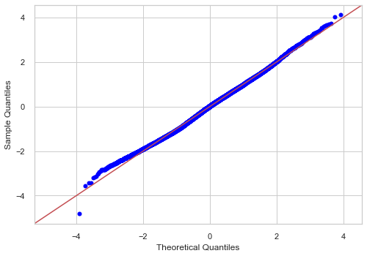
LOG MODEL QQ-PLOT
logging the model results normality and heteroscedasticity was achieved

Slide 12
CONCLUSION
The key factors are:
Waterfront location
Living area square footage
Overall grade of the property
A house with the typical features for the area retails at $528,969
The data shows most houses of average condition which shows an investment potential for our stakeholders

Slide 13
RECOMMENDATIONS
Different pricing strategies to emphasize Waterfront properties
Investment in property upgrades
Highlight spacious living areas
Emphasis on Property Grade

Slide 14
NEXT STEPS
Comparison with other regression models
Utilize supplementary data categories from the Kings County to improve the model's precision
Use of current and long term data to understand trends in the market.

Slide 15

Thank You

